Slide 1
Capstone Project Stack Route ML Wave 1

Slide 2
Question Answering System

Slide 3
Problem Statement
Build a Q&A system to hold conversation over a closed domain with following modules:
Auto completion of user queries. Prediction of next set of words based on previous words.
Co-referencing solution for multiple short sentences.
Understanding the real intention of the user by asking more questions
Summarizing the queries done by a person during a session.
Objectives:
Trainability
Scalability

Slide 4
Dataset
SQuAD
Data: Stanford Question Answering Dataset (SQuAD) is a new reading comprehension dataset, consisting of questions posed by crowdworkers on a set of Wikipedia articles, where the answer to every question is a segment of text, or span, from the corresponding reading passage. With 100,000+ question-answer pairs on 500+ documents,
Challenge: Given a context (a passage) point to an answer from within
Our Challenges
Finding an answer from 442 documents, 24K passages, 2M sentences and more than 20M words
At document level the complexity is 24K times more than the SQuAD dataset

Slide 5
Problem Scoping
Build a Q&A system to hold conversation over a closed domain with following modules:
Auto completion of user queries. Prediction of next set of words based on previous words.
Co-referencing solution for multiple short sentences
Understanding the real intention of the user by asking more questions
Summarizing the queries done by a person during a session
Pointing to a correct document →paragraph→ sentence→span when a query is asked and come up with a optimum solution.

Slide 6
Architecture
IR
Parse & Analyze
AutoFill
Question
Answer Selection
Retrieval Analysis
Response
{Answer}
Corpus
Document Tagger
Annotated corpus

Slide 7
Executive Summary - Autofill
Predict next word/sentence so as to:
Improve both precision and recall
Save user time
Discover the knowledge base
Approach:
N-Grams
Various RNN architectures

Slide 8
Executive Summary - Information Retrieval
Given a query:
Point to a document
Point to a paragraph
Point to a sentence
Approach:
Learning to rank using an ensemble of:
TF-IDF, BM25, Doc2vec
Word Mover Distance (with and without attention model)
DNN

Slide 9
Executive Summary - Answer Selection
Point to a span, given a context using Bidirectional Attentional Flow Models

Slide 10
AUTOFILL (Auto completion of user’s question or queries)

Slide 11
Problem Statement
Design a model that recommends the next word(s) within a closed domain from a set of words given by the user.
OBJECTIVE
The primary goal is to constrain the questions to our knowledge domain and hence avoid any ambiguity in finding answer.

Slide 12

Week
Analysing and discussing the project requirements.
Data gathering.
Data Preprocessing.
Surveying existing models
Training N-gram model.
Project Timeline
1
Embedding layer design
Working on various DNN models using LSTM.
2
3
Testing LSTM models with different hyperparameters

Slide 13
Flow/Approach
Data Gathering
N- gram generation
Data Preprocessing
Data Embedding
Training a Neural Model
Prediction using
Back-off
Prediction
Evaluation

Slide 14
Pre-Processing
Data gathering
SQuAD Data consists of 100,000+ questions-answers on a set of Wikipedia articles. Total vocabulary size 52000+ words
Wikipedia Data Complete 48 wikipedia articles on SQuAD topics

Slide 15
Pre-Processing
Cleaning text
Removing special characters.
Removing punctuations
Data Manipulation
Replacing Named Entity with single word.
Tokenize
Sentence tokenize
Word tokenize

Slide 16
Flow/Approach
Data Gathering
N- gram generation
Data Preprocessing
Data Embedding
Training a Neural Model
Prediction using
Back-off
Prediction
Evaluation

Slide 17
N-gram Model
Estimate probability of each word given prior context.
P(played|when was super bowl)
In general, N-gram model uses only N-1 words of prior context
Unigram: P(played)
Bigram: P(played|bowl)
Trigram: P(played|super bowl)

Slide 18
N-gram Model
Markov assumption The future behaviour of a dynamical system only depends on its recent history. In particular, in a kth-order Markov model, the next state depends only on the k most recent states. P(played|when was super bowl) ~ P(played|super bowl) ~ P(played|bowl)

Slide 19
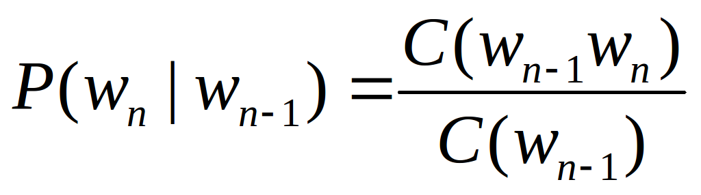
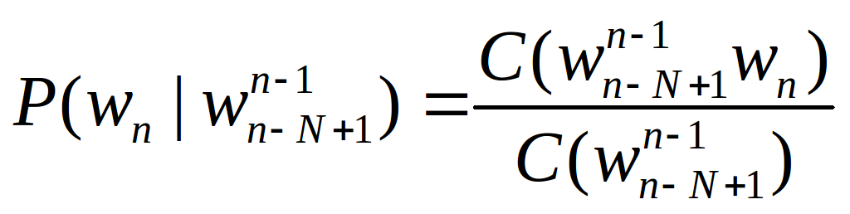
N-gram Model
N-gram conditional probabilities can be estimated from raw text based on the relative frequency of word sequences.
Bigram :
N-gram :
We have used ConditionalFreqDist() and ConditionalProbDist() from nltk.probability to compute the N-gram conditional probability

Slide 20
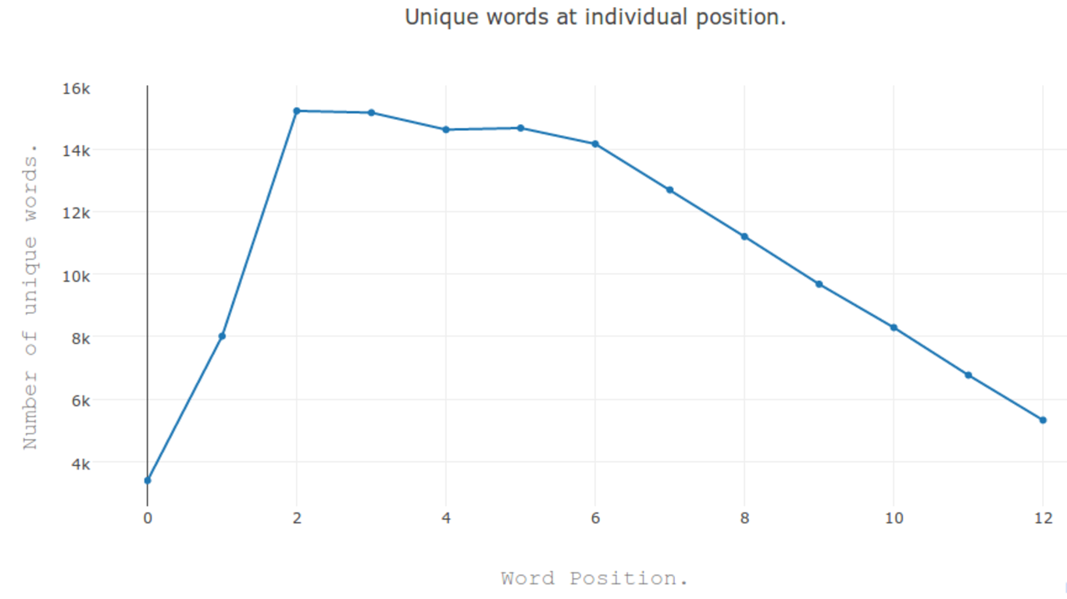
N-gram Model

Slide 21

N-gram Model
As N increases, the power of an N-gram model increases, but the ability to predicate accurate word from sparse data decreases.
Possible solution in Backoff approach
Only use lower-order model when data for higher-order model is unavailable (i.e. count is zero).
Recursively back-off to weaker models until data is available.

Slide 22
N-gram Model
Many times local context does not provide the most useful predictive clues, which instead are provided by long-distance dependencies.
Syntactic dependencies “The man next to the large oak tree near the grocery store on the corner is tall.” “The men next to the large oak tree near the grocery store on the corner are tall.”
Semantic dependencies “The bird next to the large oak tree near the grocery store on the corner flies rapidly.” “The man next to the large oak tree near the grocery store on the corner talks rapidly.”

Slide 23
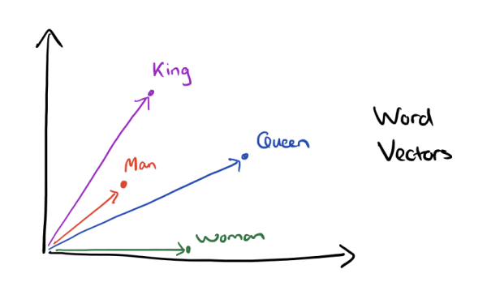
Approach - DNN
Data Embedding
Training gensim word2vec on our data.
Intersecting it with google word2vec and generating vocabulary.
King - Man + Woman = Queen

Slide 24
Sliding Window Approach
Raw Text -> “ Tesla's induction motor and transformer was licensed by whom? ”
Tokenize Text -> [ [“Tesla's”] [“induction”] [“motor”] [“and”] [“transformer”] [“was”] [“licensed”] [“by”] [“whom “] ]
Window size = 4
Input Seq Output Seq
[“Tesla's”] [“induction”] [“motor”] [“and”] [“transformer”]
[“induction”] [“motor”] [“and”] [“transformer”] [“was”]
[“motor”] [“and”] [“transformer”] [“was”] [“licenced”]
Each word will be representation in the form of Vector of size 300.
Window size = 5
Input Seq Output Seq
[“Tesla's”] [“induction”] [“motor”] [“and”] [“transformer”] [“was”]
[“induction”] [“motor”] [“and”] [“transformer”] [“was”] [“licensed”]
[“motor”] [“and”] [“transformer”] [“was”] [“licensed”] [“by”]

Slide 25
Many-In Many-Out Approach
Maximum Sentence Length = 10
Raw Text -> “ <start> In what year did Tesla die? </end> ”
Tokenize Text -> [ [<start>] [“In”] [“what”] [“year”] [“did”] [“Tesla”] [“die”] [</end>] ]
Padded Sequence -> [<start>] [“In”] [“what”] [“year”] [“did”] [“Tesla”] [“die”] [</end>] [0] [0]
Input Sequence ->
Output Sequence ->
[<start>]
[“In”]
[“what”]
[“year”]
[“did”]
[“Tesla”]
[“die”]
[</end>]
[0]
[0]
[“In”]
[“what”]
[“year”]
[“did”]
[“Tesla”]
[“die”]
[</end>]
[0]
[0]
[0]

Slide 26
LSTM with sub-samples.
“W5”
Dense Layer
LSTM Layer - 2
LSTM Layer - 2
LSTM Layer - 2
LSTM Layer - 2
LSTM Layer - 1
LSTM Layer - 1
LSTM Layer - 1
LSTM Layer - 1
Embedding Layer-300
“W1”
“W2”
“W3”
“W4”

Slide 27
LSTM with entire sequences.
“who”
“is”
“the”
....
<end>
<end>
LSTM Layer - 3
LSTM Layer - 3
LSTM Layer - 3
LSTM Layer - 3
LSTM Layer - 3
LSTM Layer - 3
LSTM Layer - 2
LSTM Layer - 2
LSTM Layer - 2
LSTM Layer - 2
LSTM Layer - 2
LSTM Layer - 2
LSTM Layer - 1
LSTM Layer - 1
LSTM Layer - 1
LSTM Layer - 1
LSTM Layer - 1
LSTM Layer - 1
Embedding Layer-300
<start>
“who”
“is”
“the”
….
<end>

Slide 28
Model Comparison
Results of various models tried for word prediction
Model | No. of Layer | No. of units in each layer | Epochs | Batch Size | Activation | Accuracy | Custom Accuracy | Threshold for custom accuracy | Word Embedding Size
LSTM w2v | 2 | 1024, 512 | 15 | 128 | relu | 18 | 31 | 0.85 | 300
LSTM w2v | 3 | 1024, 1024, 300 | 30 | 512 | relu | 41 | 53 | 0.85 | 300
LSTM w2v | 2 | 1024, 1024 | 30 | 64 | relu | 15 | 26 | 0.85 | 300

Slide 29
Probability of POS-tags
Part Of Speech Tags Model
Dense Layer
LSTM Layer - 2
LSTM Layer - 2
LSTM Layer - 2
LSTM Layer - 2
LSTM Layer - 1
LSTM Layer - 1
LSTM Layer - 1
LSTM Layer - 1
POS to Index(Categorical)
“Noun”
“Auxiliary Verb”
“Verb”
“Adj.”
Word to POS tags
“W1”
“W2”
“W3”
“W4”

Slide 30
POS-tag Model Comparison
Results of various models tried for word prediction
Model Type | No. of Layers | No. of units in each layer | No. of Epochs | Batch Size | Activation | Accuracy
LSTM | 2 | 1024, 1024 | 30 | 128 | Sigmoid | 46
LSTM | 2 | 256, 256, | 25 | 128 | Sigmoid | 44
LSTM Multiclass | 2 | 1024, 1024 | 10 | 128 | Sigmoid | 12

Slide 31
Challenges
Training Data:
Training DNN on entire SQuAD and wikipedia data → time consuming
Our model → SQuAD’s questions only
Word2vec representation:
Word-vector generated using limited vocabulary → limits model prediction
Intersected our word2vec model with Google’s word2vec model
Retaining Context:
Retaining context with input sequence
Used Many In-Many Out approach in LSTM to solve this problem.

Slide 32
Challenges
Time Constraints:
Very high Training times
limited variation in hyperparameter (no. of layers, layer size, epochs)
Unable to train LSTM stateful model (batch size - entire dataset)
Time : 2 hours per epoch on server
Repeated words in prediction
Possible solution - Ensembling POS-tag model with Word2Vec model

Slide 33
State of the Art Models
Natural Language Generation Model by Andrej Karpathy:
Naturalism and decision for the majority of Arab countries' capitalide was grounded by the Irish language by [[John Clair]], [[An Imperial Japanese Revolt]], associated with Guangzham's sovereignty. His generals were the powerful ruler of the Portugal in the [[Protestant Immineners]], which could be said to be directly in Cantonese Communication, which followed a ceremony and set inspired prison, training.
I've the RNN with and works, but the computed with program of the RNN with and the computed of the RNN with with and the code.

Slide 34
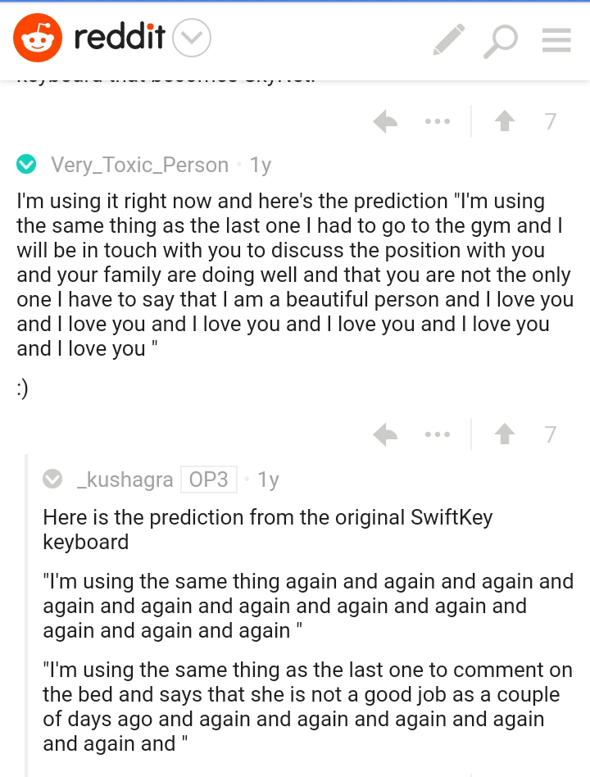
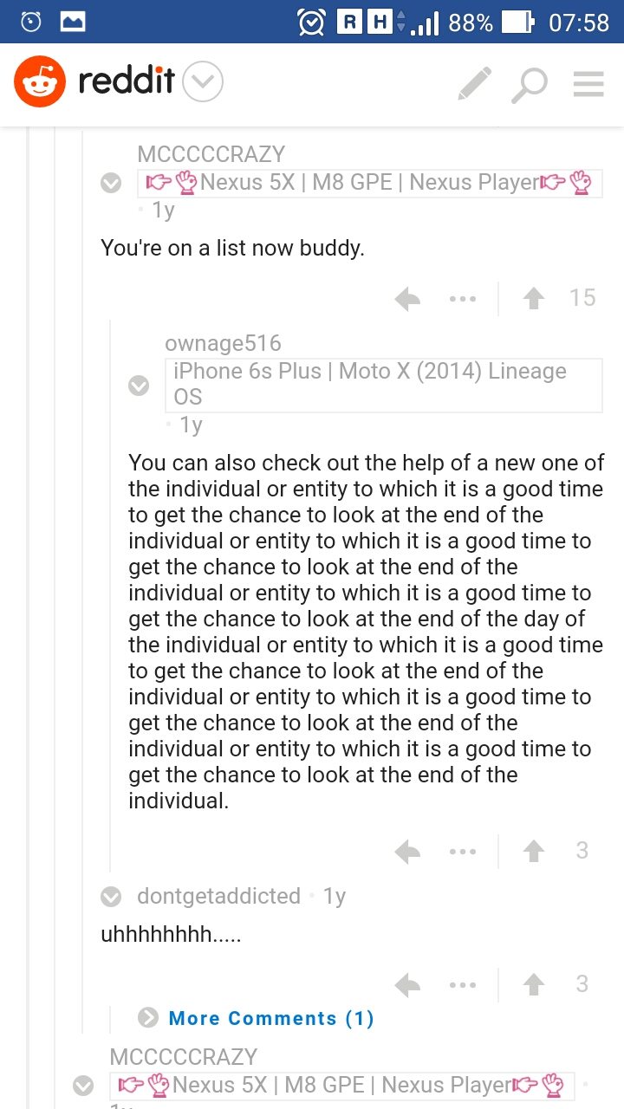
Swiftkey Neural

Slide 35
DEMO
SOURCE CODE LINK - https://github.com/nishant-jain-94/Autofill

